Slide 1
Metro Traffic Volume Prediction

Slide 2




HELLO! We r doing a project Metro Traffic Volume
K.Sri Satya
K.S.N.Swamy
P.Durga Prasad

Slide 3
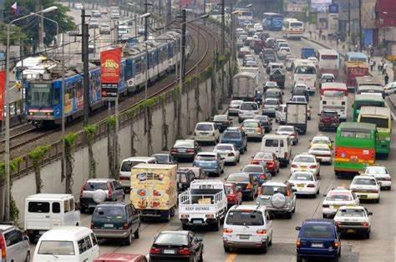
Objective
Our objective of this project is to build a model that will predict traffic volume for future based on previous traffic volume data. In this process we use linear regression algorithm in machine learning using python programming language. Python is a open source software to build any application in machine learning. We also used flask to develop web page.

Slide 4
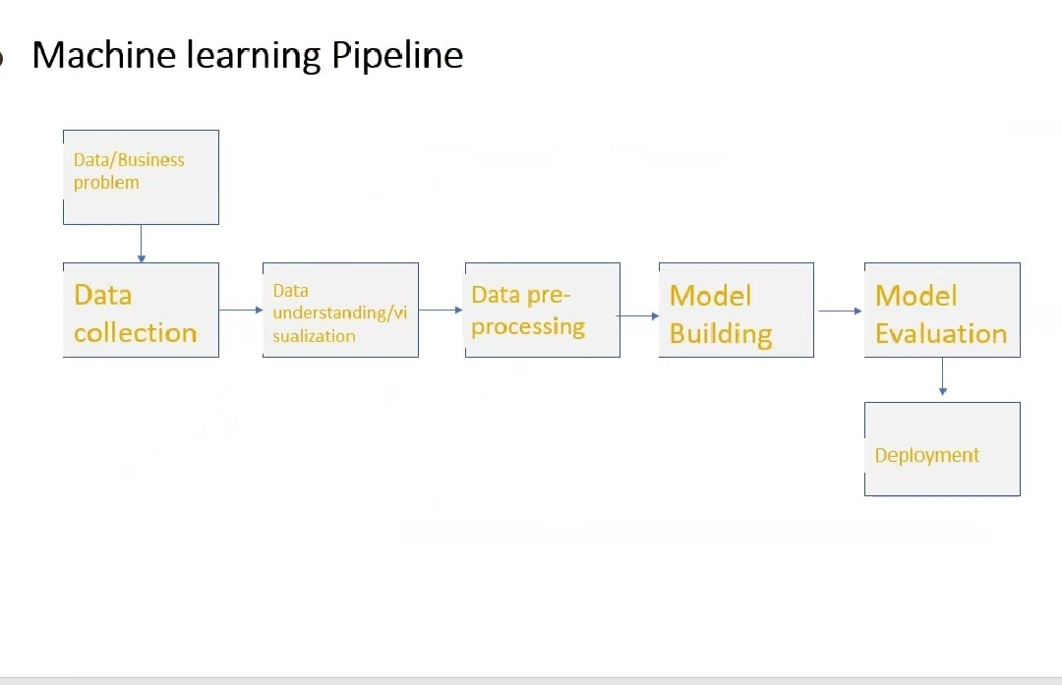

Slide 5
TOOLS USED:
Spyder: To develop a program in machine learning.
Sublime text: To develop a webpage.
Flask: To develop a web frame work in python.
Method to develop:
We used the the regression technique to predict the traffic volume in that regression we used linear regression

Slide 6
Regression:
Regression algorithms are used if there is a relationship between the input variable and the output variable. It is used for the prediction of continuous variables, such as Weather forecasting, Market Trends, etc. Below are some popular Regression algorithms which come under supervised learning
Linear Regression:
It is one of the most widely known modeling technique. Linear regression is usually among the first few topics which people pick while learning predictive modeling. In this technique, the dependent variable is continuous, independent variable(s) can be continuous or discrete, and nature of regression line is linear.
Linear Regression establishes a relationship between dependent variable (Y) and one or more independent variables (X) using a best fit straight line (also known as regression line).

Slide 7
INPUTS REQUIRED
Holiday
Temperature
Rain
Snow
Clouds
Weather
Date and Time

Slide 8
MODULES TO IMPORT
Pandas
Numpy
Label encoder module
Metrics

Slide 9

About Modules
Pandas : Pandas is an open-source Python Library providing high-performance data manipulation and analysis
tool using its powerful data structures. The name Pandas is derived from the word Panel Data – an Econometrics
from Multidimensional data.
Key Features of pandas
Fast and efficient DataFrame object with default and customized indexing.
Tools for loading data into in-memory data objects from different file formats.
Data alignment and integrated handling of missing data.
Reshaping and pivoting of date sets.
Label-based slicing, indexing and subsetting of large data sets.
Columns from a data structure can be deleted or inserted.
Group by data for aggregation and transformations.
High performance merging and joining of data.
Time Series functionality.

Slide 10

Numpy: Numpy is a general-purpose array-processing package. It provides a high-performance multidimensional array object, and tools for working with these arrays.
METRICS MODULE :
The metrics that you choose to evaluate your machine learning algorithms are very important.
Choice of metrics influences how the performance of machine learning algorithms is measured and compared. They influence how you weight the importance of different characteristics in the results and your ultimate choice of which algorithm to choose.
.

Slide 11

Label encoder module:
In machine learning, we usually deal with datasets which contains multiple labels in one or more than one columns. These labels can be in the form of words or numbers. To make the data understandable or in human readable form, the training data is often labeled in words.
Label Encoding refers to converting the labels into numeric form so as to convert it into the machine-readable form. Machine learning algorithms can then decide in a better way on how those labels must be operated. It is an important pre-processing step for the structured dataset in supervised learning.

Slide 12
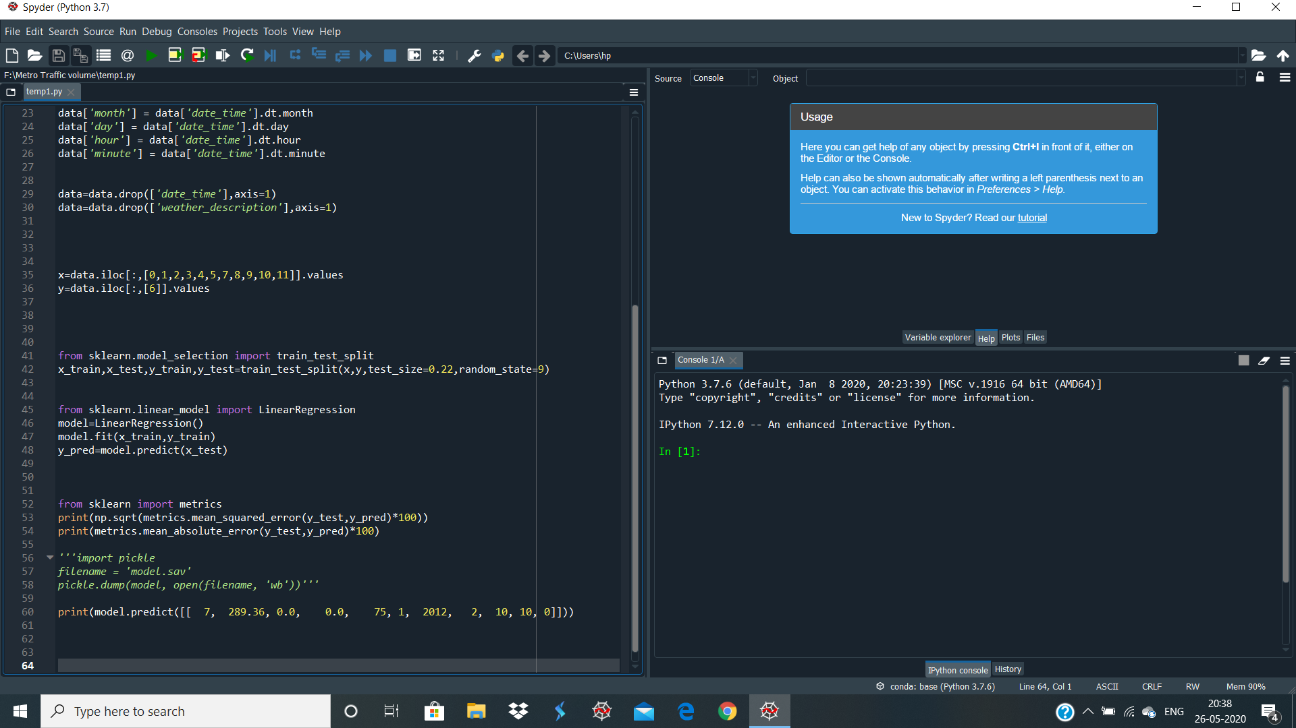
Code:

Slide 13
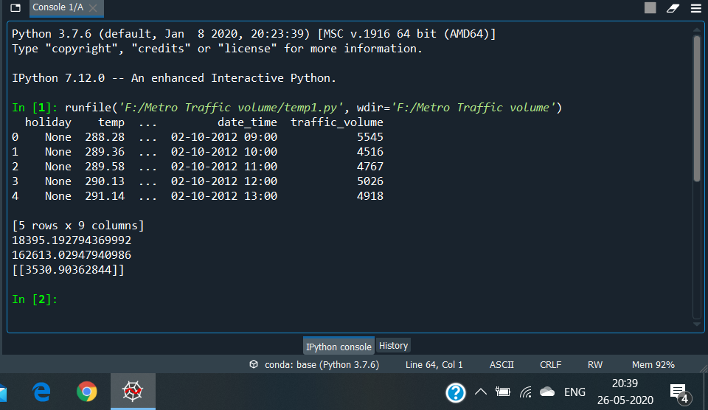
Output:

Slide 14
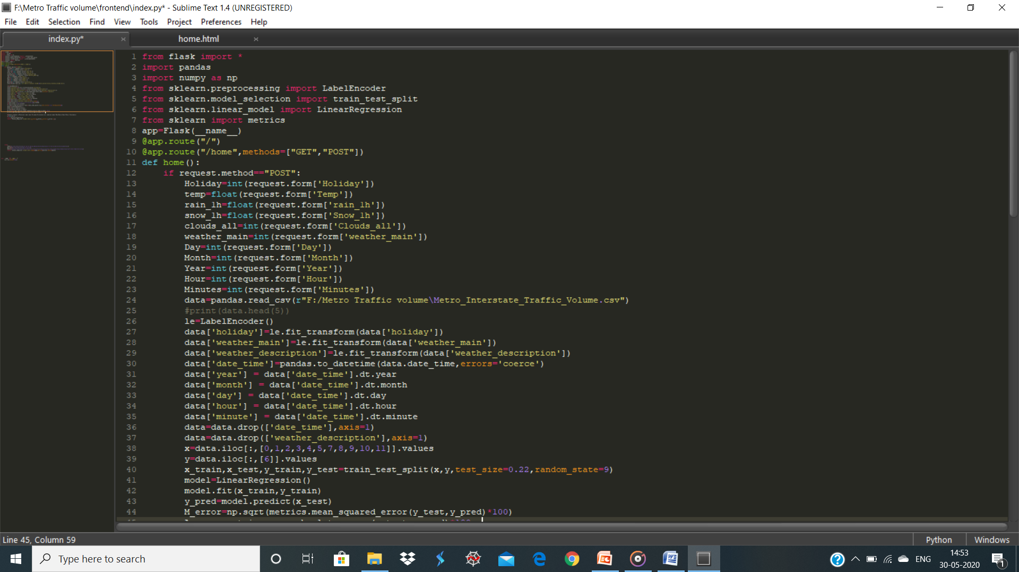
Web Page Using Flask In sublime Text:

Slide 15
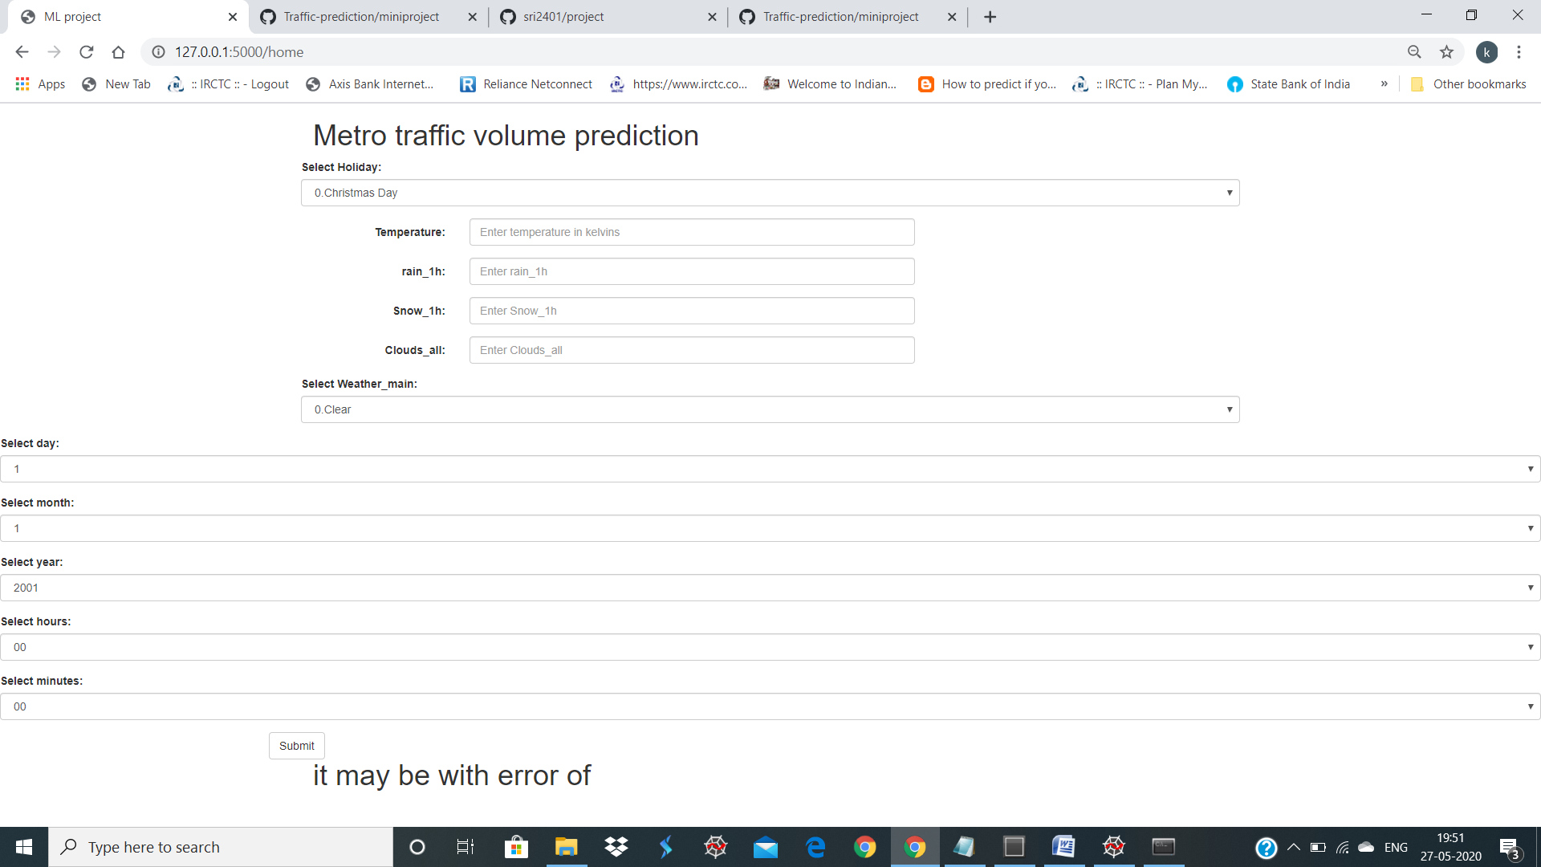
Web Page:

Slide 16
ADVANTAGE By using this we can easily predict the future Traffic volume, it may not be accurate but it gives the estimation of the traffic by giving the inputs based on above shown .

Slide 17
Thank You!

